Slide 1



Nico Rafael
Multi Platform Analytics
Portfolio Link

Slide 2
Nico Rafael
Problem & Goal
The purpose of this project was to provide insight across a business’s ecommerce platforms: TikTok Shop and Squarespace.
This is a replication of an experience I had working with a local business using synthetic datasets. The results and recommendations in this project are similar to what I provided to the real business.
Over the past two years, the owner had noticed sales were going down, and it was growing more challenging to get views on social media.
I identified top selling products, regions that made the most purchses, and opportunities to increase sales overall.
Portfolio Link

Slide 3





Nico Rafael
Tools Used
Portfolio Link

Slide 4
Nico Rafael
SQL and Modeling Workflow
Imported raw datasets from TikTok and Squarespace including gross and net sales, product, and customer data.
Standardized formats and handled missing values (coalesced null values) for consistent calculations and accounted for gaps in daily sales metrics
Modeled data using SQL joins to build analysis-ready table that shows total sales of the business
Produced final visualizations in Power BI and portfolio reporting such as top-selling products, top purchasing locations, and platform sales comparison
Portfolio Link

Slide 5
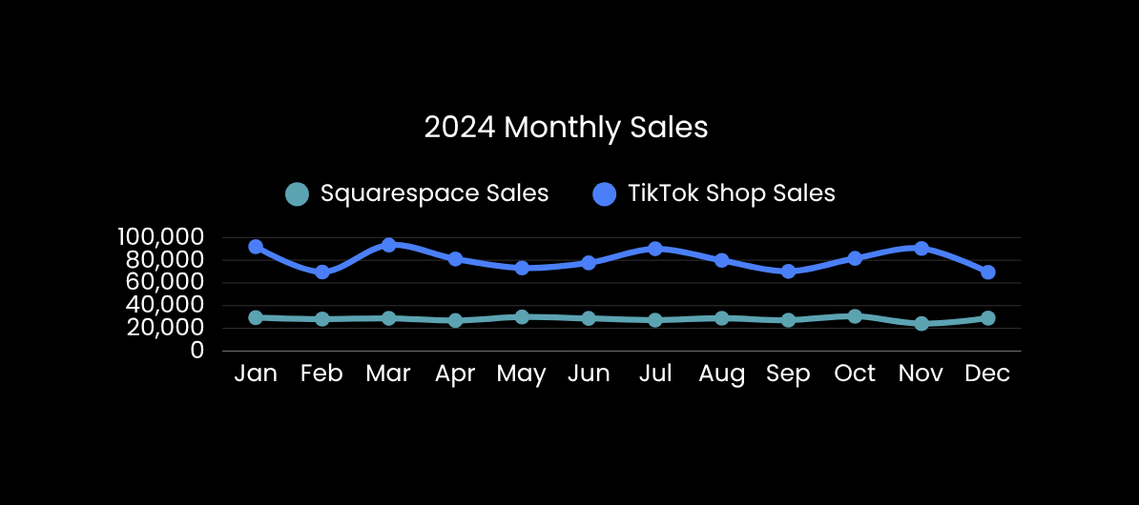
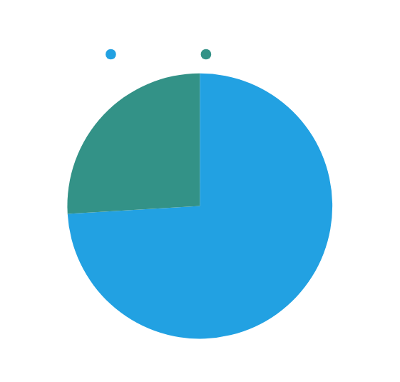
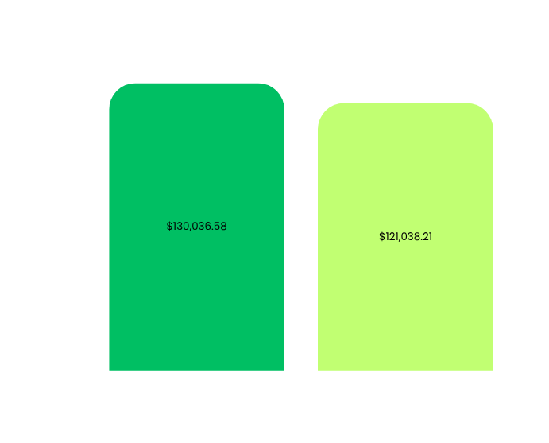
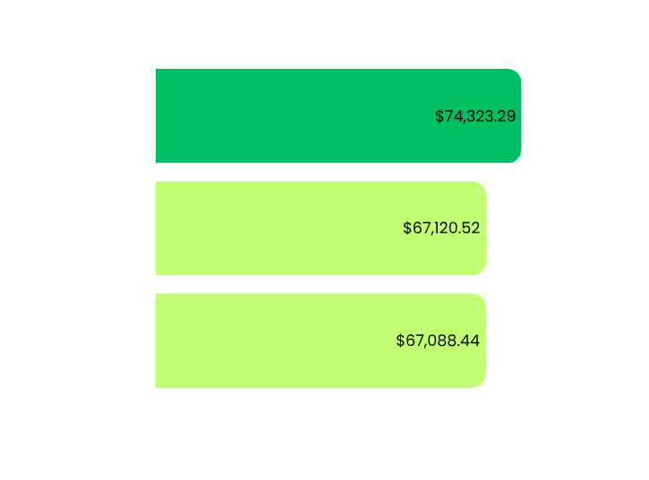
Insights
Total Earnings
Top Product Earnings
Top Purchasing States
$1.3 MILLION
$251,075
$208,533
TikTok Shop generated 74% of sales
70% of Squarespace sales generated
from Anime Mystery Box and Naruto Hoodie
18% more sales generated than
all other purchasing states

Slide 6
Nico Rafael
BUSINESS RECOMMENDATIONS
Increase marketing investment toward top‑selling products across TikTok Shop and Squarespace
Prioritize marketing in Texas, California, and Florida with top‑selling products
Explore additional product opportunities or in‑person sales channels, including targeted marketing and live events in high‑purchasing states
Further investigate Squarespace operational and marketing performance to improve platform‑specific sales
Analyze the remaining product catalog to determine opportunities for increasing sales
Portfolio Link

Slide 7
Nico Rafael
Impact
Identifying top-selling products resulted in 30% savings in the marketing budget. A clearance sale of all other products was used as an opportunity to clear out inventory and promote the company’s rebrand.
Moving forward, the business will be focusing on an anime trivia card game that is expected to sell consistently throughout the year and not just during winter/ holiday season. I recommend focusing on the new hero product, but still keeping the top sellers or at least have them as seasonal items only.
While this is a synthetic dataset, you can view the progress we’ve made with the real business here
Portfolio Link

Slide 8
Nico Rafael
For full details and a breakdown of this project, please refer to my GitHub below
Thank you
GitHub
LinkedIn
nrafael@gmail.com

